Slide 1


Kevin Rio Harristyando
21 November 2023

Slide 2

Outline
Executive Summary
Introduction
Methodology
Results
Conclusion
Appendix

Slide 3
Executive Summary
Summary of methodologies
Data Collection Through API
Data Collection with Web-Scraping
Data Wrangling
Exploratory Data Analysis (EDA) with SQL
Perform interactive visual analytics using Folium and Plotly Dash
Perform predictive analysis using classification models
Summary of all results
Exploratory Data Analysis result
Interactive analytics in screenshots
Predictive Analytics result

Slide 4
Introduction
Project background and context
Space X advertises Falcon 9 rocket launches on its website with a cost of 62 million dollars; other providers cost upward of 165 million dollars each, much of the savings is because Space X can reuse the first stage. Therefore if we can determine if the first stage will land, we can determine the cost of a launch. This information can be used if an alternate company wants to bid against space X for a rocket launch. The primary challenge addressed in this machine learning project is to predict whether the first stage of a Falcon 9 rocket will successfully land or not. By accurately predicting the landing outcome, potential clients or competing companies can make informed decisions when considering SpaceX as a launch provider or bidding against SpaceX for a rocket launch contract.
Problems you want to find answers
Can we accurately predict whether the first stage of a Falcon 9 rocket will successfully land or not?
How can the predictions from the machine learning model be utilized in the decision-making process for potential clients or competing companies considering SpaceX for a rocket launch?
What insights can be gained from the exploratory data analysis regarding the distribution of key features and potential patterns related to landing outcomes?
How accurate, precise, and reliable is the model in predicting first stage landing outcomes?

Slide 5

Section 1

Slide 6
Methodology
Executive Summary
Data collection methodology:
Data was collected using SpaceX API and Web-Scraping from Wikipedia
Perform data wrangling
One-hot encoding was applied to categorical features and Data Standardization
Perform exploratory data analysis (EDA) using visualization and SQL
Perform interactive visual analytics using Folium and Plotly Dash
Perform predictive analysis using classification models
How to build, tune, evaluate classification models

Slide 7
Data Collection
Data Collection was initiated the data collection process by utilizing a GET request to the SpaceX API.
Following this, we decoded the response content using the .json() function and transformed it into a pandas dataframe using the .json_normalize() method.
Subsequently, we conducted data cleaning, examined for any missing values, and addressed them as needed.
Additionally, we engaged in web scraping from Wikipedia to retrieve Falcon 9 launch records using BeautifulSoup, in order to extract the launch records presented in an HTML table, parse the table, and convert the information into a pandas dataframe for subsequent analysis.

Slide 8
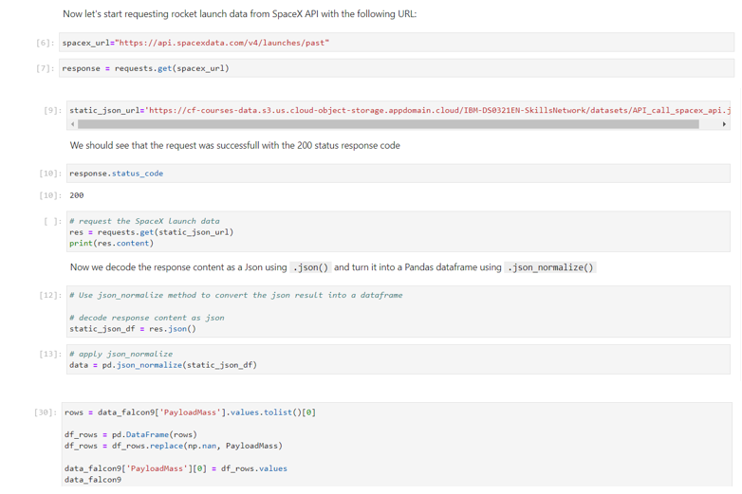
Data Collection – SpaceX API
We used the get request to the SpaceX API to collect data, clean the requested data and did some basic data wrangling and formatting.
Link Notebook: https://github.com/kevinrioharris/IBM-Courses-Data-Science/blob/main/Applied%20Data%20Science%20Capstone/Data%20Collection%20API_FinalPresentation.ipynb

Slide 9
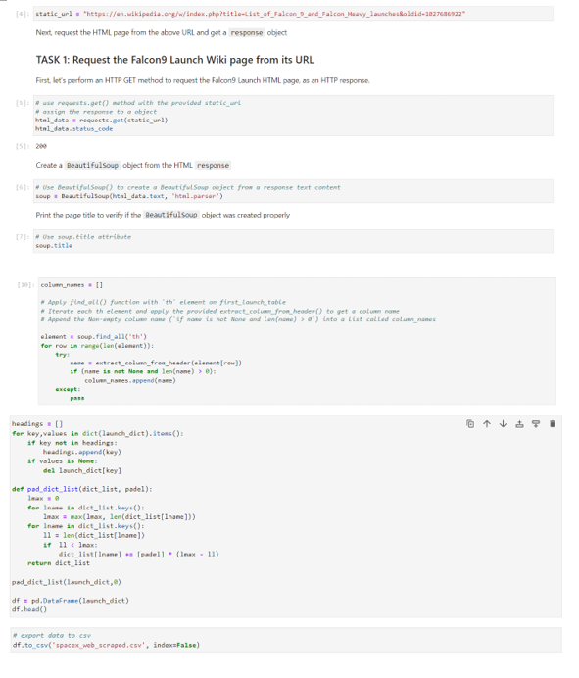
Data Collection - Scraping
We applied web scrapping to webscrap Falcon 9 launch records with BeautifulSoup
We parsed the table and converted it into a pandas dataframe.
Link Notebook: https://github.com/kevinrioharris/IBM-Courses-Data-Science/blob/main/Applied%20Data%20Science%20Capstone/Data%20Collection%20with%20Web%20Scraping_FinalPresentation.ipynb

Slide 10
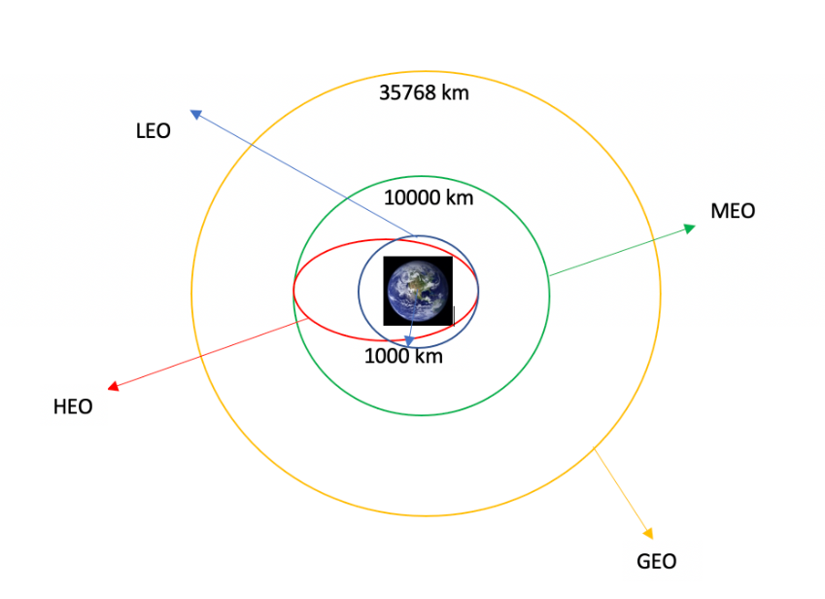
Data Wrangling
We conducted exploratory data analysis to establish training labels, computed launch counts per site, and analyzed orbit frequencies.
Additionally, we derived landing outcome labels from the outcome column and exported the findings to a CSV file.
Link notebook: https://github.com/kevinrioharris/IBM-Courses-Data-Science/blob/main/Applied%20Data%20Science%20Capstone/Data%20Wrangling_FinalPresentation.ipynb

Slide 11
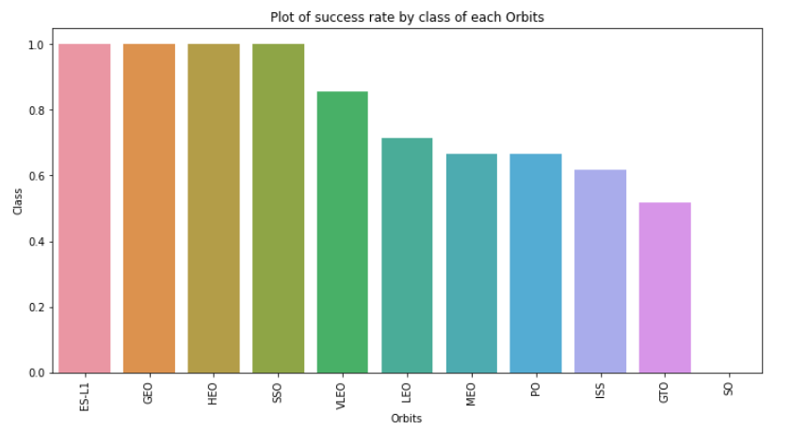
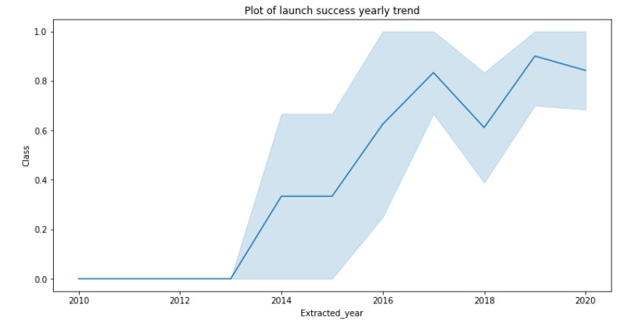
EDA with Data Visualization
We explored the data by visualizing the relationship between flight number and launch Site, payload and launch site, success rate of each orbit type, flight number and orbit type, the launch success yearly trend.
And As we can see that the sucess rate since 2013 kept increasing till 2020
Link Notebook: https://github.com/kevinrioharris/IBM-Courses-Data-Science/blob/main/Applied%20Data%20Science%20Capstone/EDA%20with%20Data%20Visualization_FinalPresentation.ipynb

Slide 12
EDA with SQL
We seamlessly imported the SpaceX dataset into a PostgreSQL database within the Jupyter notebook.
Employing EDA with SQL for exploratory data analysis, we extracted key insights, including:
The names of unique launch sites in the space mission.
The total payload mass carried by boosters launched by NASA (CRS)
The average payload mass carried by booster version F9 v1.1
The total number of successful and failure mission outcomes
The failed landing outcomes in drone ship, their booster version and launch site names.
Link Notebook: https://github.com/kevinrioharris/IBM-Courses-Data-Science/blob/main/Applied%20Data%20Science%20Capstone/EDA%20with%20SQL_FinalPresentation.ipynb

Slide 13
Build an Interactive Map with Folium
We marked all launch sites, and added map objects such as markers, circles, lines to mark the success or failure of launches for each site on the folium map.
We assigned the feature launch outcomes (failure or success) to class 0 and 1.i.e., 0 for failure, and 1 for success.
Using the color-labeled marker clusters, we identified which launch sites have relatively high success rate.
We calculated the distances between a launch site to its proximities. We answered some question for instance:
Are launch sites near railways, highways and coastlines.
Do launch sites keep certain distance away from cities.
Link notebook: https://github.com/kevinrioharris/IBM-Courses-Data-Science/blob/main/Applied%20Data%20Science%20Capstone/Interactive%20Map%20with%20Folium_FinalP.ipynb

Slide 14
Build a Dashboard with Plotly Dash
We built an interactive dashboard with Plotly dash
We plotted pie charts showing the total launches by a certain sites
We plotted scatter graph showing the relationship with Outcome and Payload Mass (Kg) for the different booster version.
Link Code: https://github.com/kevinrioharris/IBM-Courses-Data-Science/blob/main/Applied%20Data%20Science%20Capstone/PlotlyApps.py

Slide 15
Predictive Analysis (Classification)
We loaded the data using numpy and pandas, transformed the data, split our data into training and testing.
We built different machine learning models and tune different hyperparameters using GridSearchCV.
We used accuracy as the metric for our model, improved the model using feature engineering and algorithm tuning.
We found the best performing classification model.
Link Notebook: https://github.com/kevinrioharris/IBM-Courses-Data-Science/blob/main/Applied%20Data%20Science%20Capstone/Machine%20Learning%20Prediction_FinalP.ipynb

Slide 16
Results
Best classification model is DecisionTree with a accuracy score of 0.8732142857142856

Slide 17

Section 2

Slide 18

Flight Number vs. Launch Site
From the plot, we found that the larger the flight amount at a launch site, the greater the success rate at a launch site.

Slide 19

Payload vs. Launch Site
The Greate the Payload mass for launch site CCAFS SLC 40, The higher the success rate for the rocket.

Slide 20

Success Rate vs. Orbit Type
From the plot, we can see that ES-L1, GEO, HEO, SSO, VLEO had the most success rate.

Slide 21

Flight Number vs. Orbit Type
The plot below shows the Flight Number vs. Orbit type. We observe that in the LEO orbit, success is related to the number of flights whereas in the GTO orbit, there is no relationship between flight number and the orbit.

Slide 22

Payload vs. Orbit Type
We can observe that with heavy payloads, the successful landing are more for PO, LEO and ISS orbits.

Slide 23

Launch Success Yearly Trend
From the plot, we can observe that success rate since 2013 kept on increasing till 2020.

Slide 24
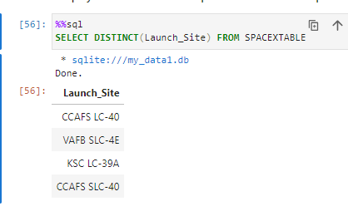
All Launch Site Names
We used the keyword DISTINCT on the LaunchSite to show only unique launch sites from the SpaceX data.
It shows
CCAFS LC-40
VAFB SLC-4E
KSC LC-39A
CCAFS SLC-40

Slide 25
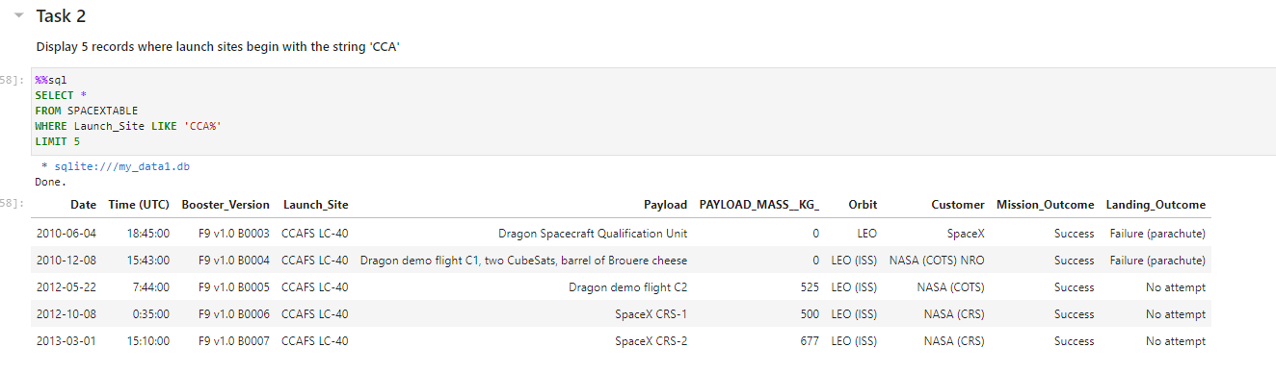
Launch Site Names Begin with 'CCA'
We used the query above to display 5 records where launch sites begin with `CCA` by using LIKE function and LIMIT for displaying only 5

Slide 26
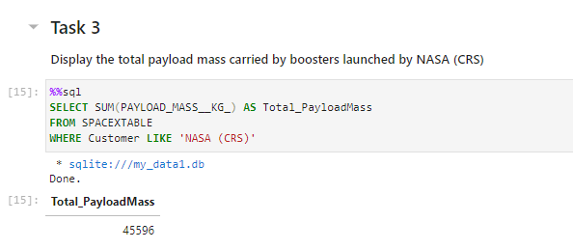
Total Payload Mass
We calculated the total payload carried by boosters launched by NASA is 45596 using the query below

Slide 27
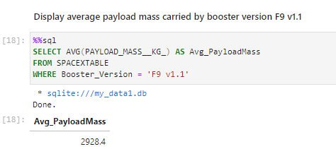
Average Payload Mass by F9 v1.1
We calculated the average payload mass carried by booster version F9 v1.1 is 2928.4

Slide 28
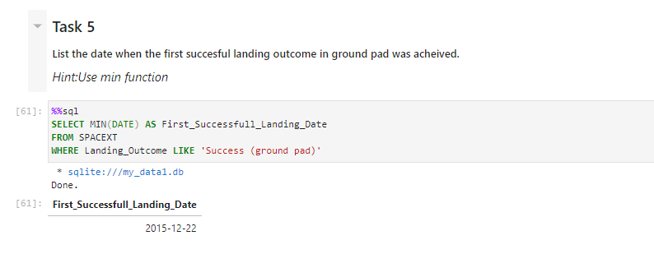
First Successful Ground Landing Date
We observed that the dates of the first successful landing outcome on ground pad was 22nd December 2015

Slide 29
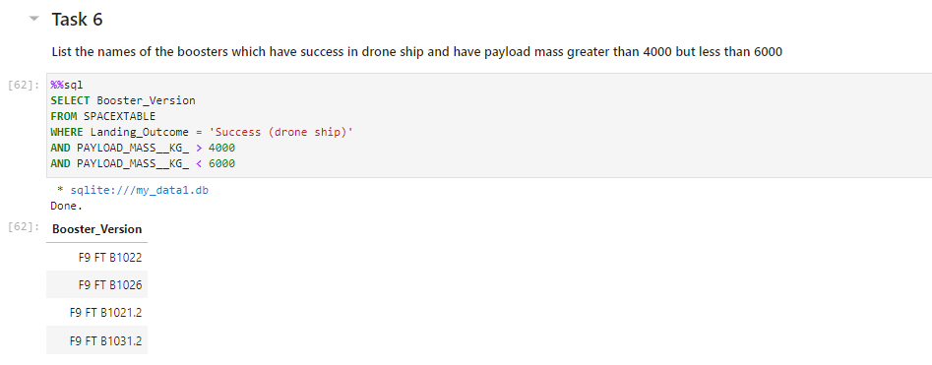
Successful Drone Ship Landing with Payload between 4000 and 6000
We used the WHERE clause to filter for boosters which have successfully landed on drone ship and applied the AND condition to determine successful landing with payload mass greater than 4000 but less than 6000

Slide 30
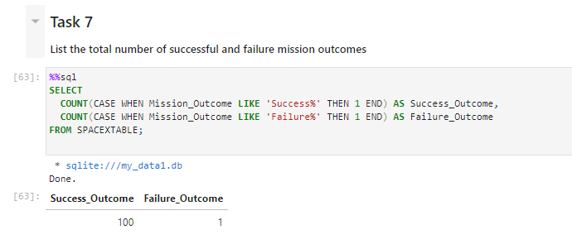
Total Number of Successful and Failure Mission Outcomes
We used wildcard like ‘%’ to filter for WHERE MissionOutcome was a success or a failure.
We used CASE function to make it shorter code for doing both Mission_Outcome : Success or Failure

Slide 31
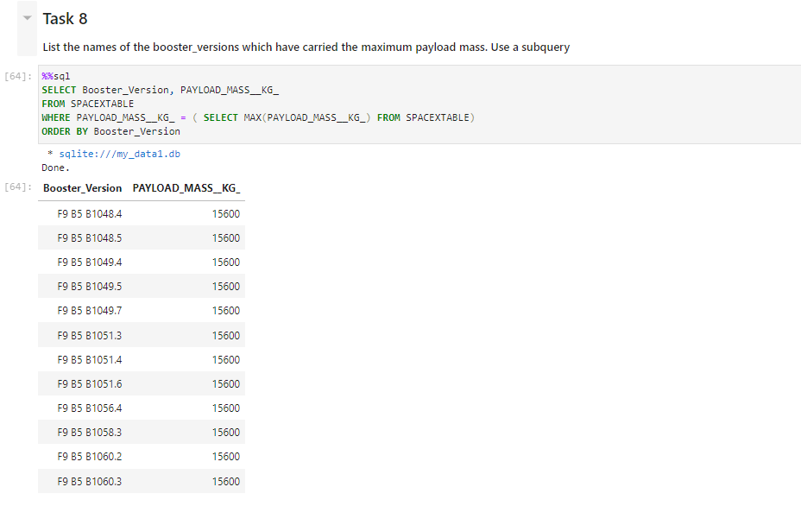
Boosters Carried Maximum Payload
We determined the booster that have carried the maximum payload using a subquery in the WHERE clause and the MAX() function.
Where The maximum payload is 15600 KG

Slide 32
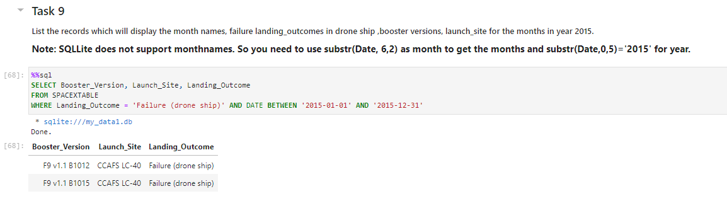
2015 Launch Records
We used a combinations of the WHERE clause, LIKE, AND, and BETWEEN conditions to filter for failed landing outcomes in drone ship, their booster versions, and launch site names for year 2015

Slide 33
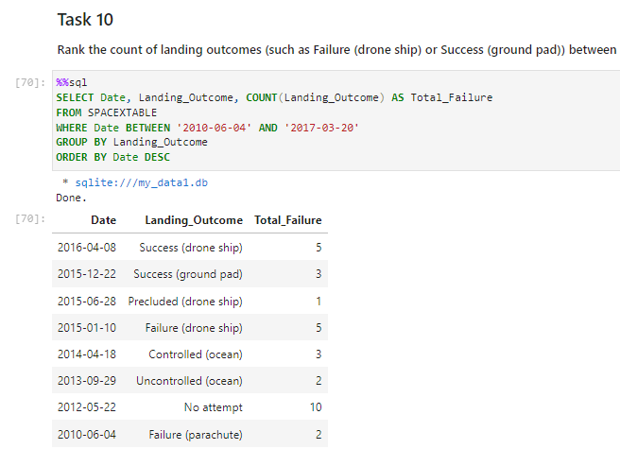
Rank Landing Outcomes Between 2010-06-04 and 2017-03-20
We selected Landing outcomes and the COUNT of landing outcomes from the data and used the WHERE clause to filter for landing outcomes BETWEEN 2010-06-04 to 2010-03-20.
We applied the GROUP BY clause to group the landing outcomes and the ORDER BY clause to order based on date in descending order.

Slide 34

Section 3

Slide 35
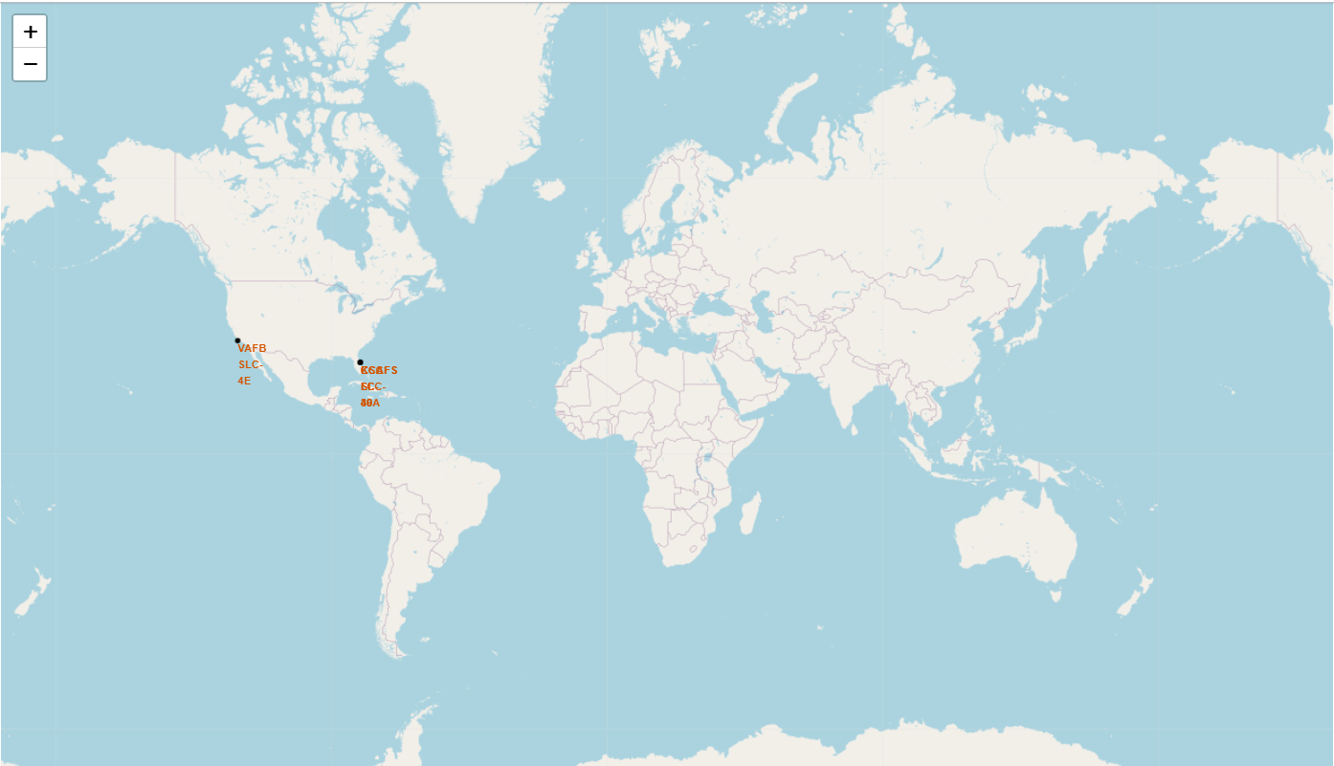
All Launch Sites Global Map Markers
We can see that the SpaceX Launch Site are in the United States of America coasts: Florida and California

Slide 36
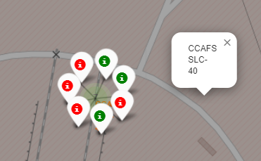
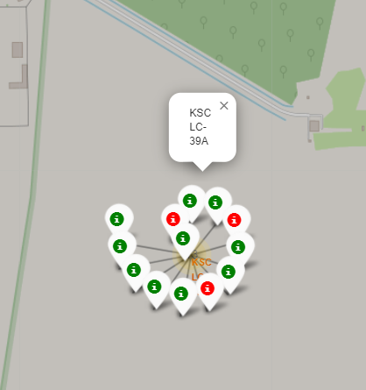
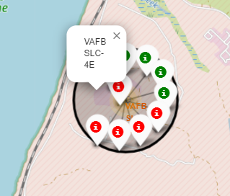
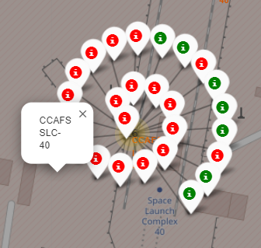
Markers showing successful launch using color labels
Florida Launch Sites
California Launch Sites
Green Marker Shows successful Launch
Red Marker Shows Failures Launch

Slide 37
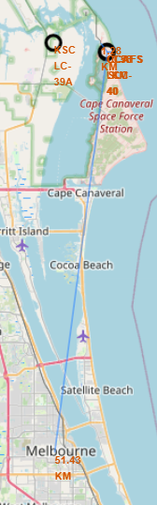
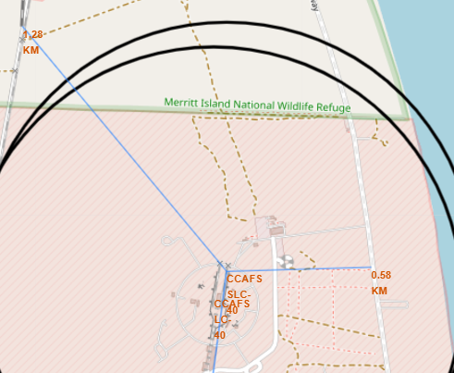
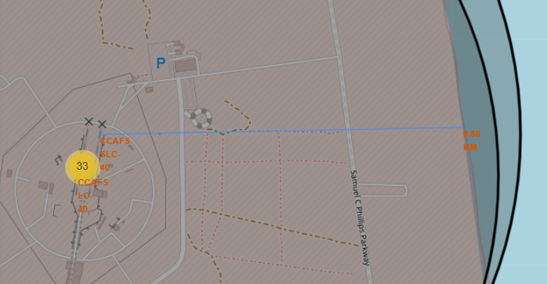
Launch Site (CCAFS SLC-40) Distance to Landmarks
distance_highway = 0.5834695366934144 km
distance_railroad = 1.2845344718142522 km
distance_city = 51.434169995172326 km
Are launch sites in close proximity to railways? No
Are launch sites in close proximity to highways? No
Are launch sites in close proximity to coastline? Yes
Do launch sites keep certain distance away from cities? Yes

Slide 38

Section 4

Slide 39
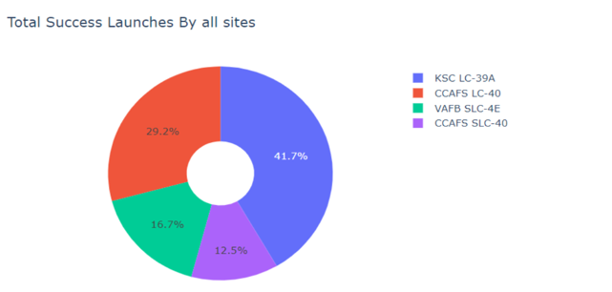
Pie Chart Showing The Success Percentage Achieved from Each Launch Site
We can see that KSC LC-39A had the most successful launches from all Launch Sites.

Slide 40
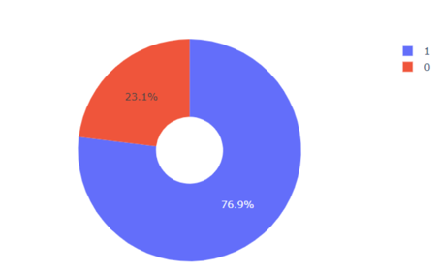
Pie Chart Showing The Launch Site with The Highest Launch Success Ratio
KSC LC-39A Achieved 76,9% success rate while getting 23,1% failure rate
1 means Success
0 means Failure

Slide 41
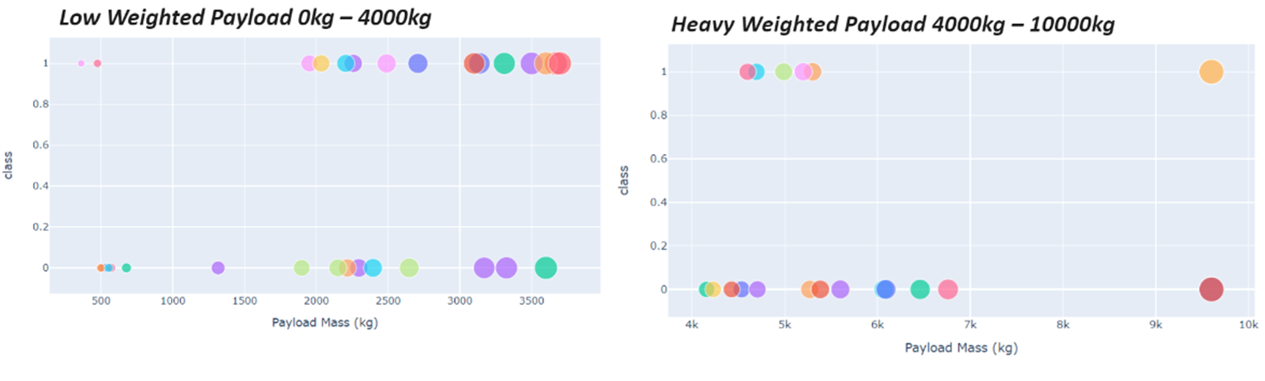
Scatter Plot of Payload vs Launch Outcome for All Launch Sites (with Different Payloads)
Based on the graph above, We can see the success rates for low weighted payloads is higher than the heavy weighted payloads

Slide 42

Section 5

Slide 43

Classification Accuracy
Based on the code above, The decision tree classifier is the model with the highest classification accuracy

Slide 44

Confusion Matrix
The confusion matrix for the decision tree classifier shows that the classifier can distinguish between the different classes. The major problem is the false positives .i.e., unsuccessful landing marked as successful landing by the classifier.

Slide 45
Conclusions
In summary:
A launch site's success rate is positively correlated with the magnitude of flights conducted there.
The launch success rate witnessed a continuous rise from 2013 to 2020.
Orbits ES-L1, GEO, HEO, SSO, and VLEO exhibited the highest success rates.
Among all launch sites, KSC LC-39A boasted the highest number of successful launches.
The Decision tree classifier stands out as the most effective machine learning algorithm for this analysis.

Slide 46


